Slide 1
Institut Mines-Télécom
A leading group of grandes écoles
in engineering, science and management
Bhumika GUPTA, Ph.D
E-mail: bhumika.gupta@telecom-em.eu
Professor (Human Resource Management & Ogranisation Behaviour)
Director (MSc in International Management)
TELECOM BUSINESS SCHOOL
PARIS, FRANCE

Slide 2
Education at a glance
13 000 students in Masters of Engineering, Masters in Management, Masters of Science and PhDs
3 900 graduates per year
1450 faculty members
500 international academic partners
30% of foreign students, 60 nationalities
Teaching languages: French and English

Slide 3
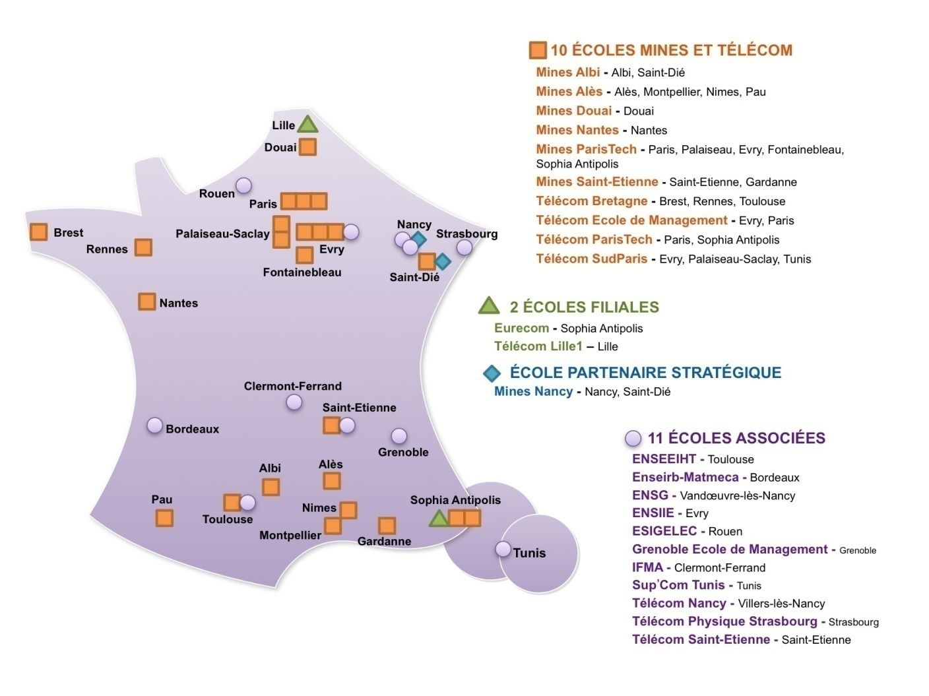
School of Management of the Institut Mines-Télécom
1rst group of engineering schools in France
12,000 students
1,500 full time faculty members
Over 2,000 graduates per year

Slide 4


Telecom Business School
GRANDE ÉCOLE DE MANAGEMENT

Slide 5








Institution of higher education and research and a member of: Institut MINES-TELECOM, Association to Advance Collegiate Schools of Business (AACSB), Chapitre des Ecoles de Management de la Conférence des Grandes Ecoles, Fondation Nationale pour l’Enseignement de la Gestion (FNEGE).
Important Accreditations
AMBA Accreditation : Association of Master of Business Administration
European Foundation for Management Development (EFMD),

Slide 6
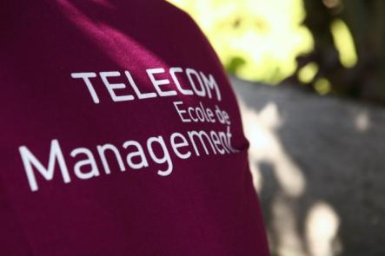
Rankings
24th in the Master's in Management ranking of the Financial Times (2nd in “e-business”)
2nd best business school in France for Financial Aid (Challenges, December 2013)
2nd best business school in France for “Added Value” (Le Point, February 2013)
4th best business school in France regarding salary upon graduation (Challenges, December 2011)
6th best business school in France (Le Nouvel Observateur, January 2012)
6th best business school in France for pedagogy (Le Point, February 2012)
page 6

Slide 7
Key Numbers
80+
1
1
12
6
2
3
1
1
100+
700+
40mn
Nationalities on Campus
Professor for 18 students
Integrated Master’s in Management
Specialized Majors for the Master’s in Management
Specialized Master’s Degrees
Masters of Science
Summer School Program Options
Executive MBA
PhD
Partner Universities
On-campus Student Housing Units
From the Center of Paris

Slide 8

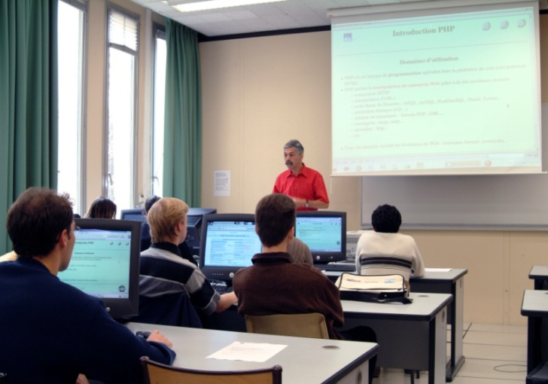


Quality Resources
One professor for every 18 students
Unlimited internet access, IT center open 24/7, Wifi
30,500 media resources/publications in our online library
Audiovisual studio
Radio studio
Multimedia Language Laboratory
Business accelerator (incubator)

Slide 9
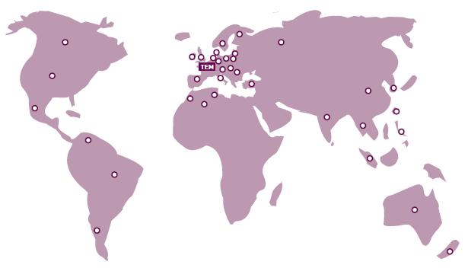


Our Partners
Argentina, Australia,
Brazil, Barbados,
Canada, Columbia, Czech Republic,
Denmark,
Estonia,
Finland,
Great Britain, Germany,
Hungary, Hong Kong,
India, Ireland, Italy,
Japan,
Malaysia, Mexico,
New-Zealand, Netherlands,
Philippines, Poland, Portugal,
Romania, Russia, Republic of China,
Spain, Slovakia, Slovenia,
Sweden, South Korea,
South Africa, Singapore,
Taiwan, Thailand, Tunisia, Turkey,
United States of America,
Venezuela
Vietnam

Slide 10
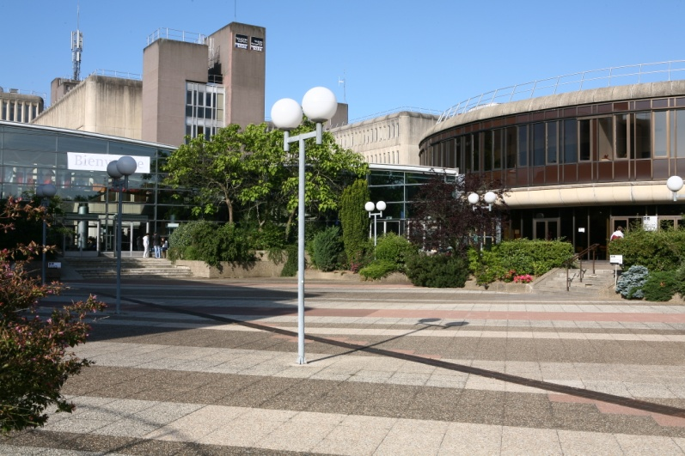
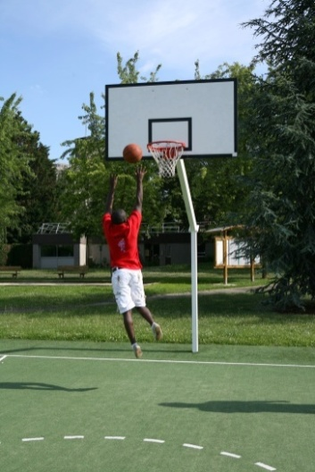
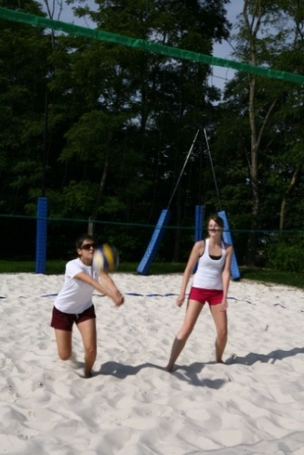
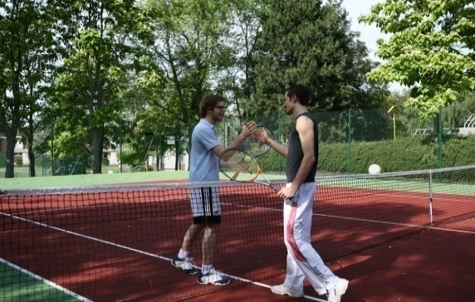
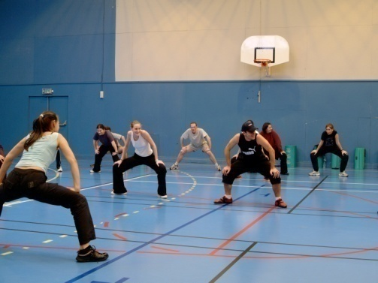

The Campus
Paris is 40 mins by train and 30 mins by car
Train station 5 mins away, by foot
RER station: 35 kms from Paris (20 mins by car)
Beautiful and safe campus
Shared with a school of engineering
With numerous facilities, sports activities and active student associations and clubs

Slide 11
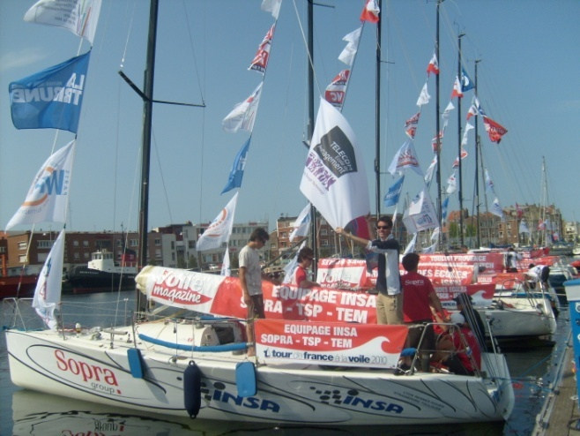




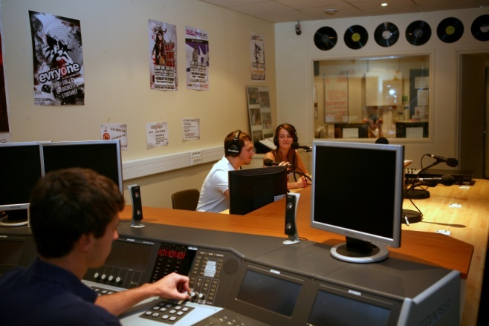



Student Life on Campus
More than 60 clubs and associations:
To discover a new activity
To practice your passion
Get to know our associations:
- Bureau Des Élèves (Student Office)
- Sports Club
- Art Club
- Student Radio (2nd in France)
- Young Entrepreneurs
- Musical Theater
- Students Club welcoming
International Students!
And many more!

Slide 12
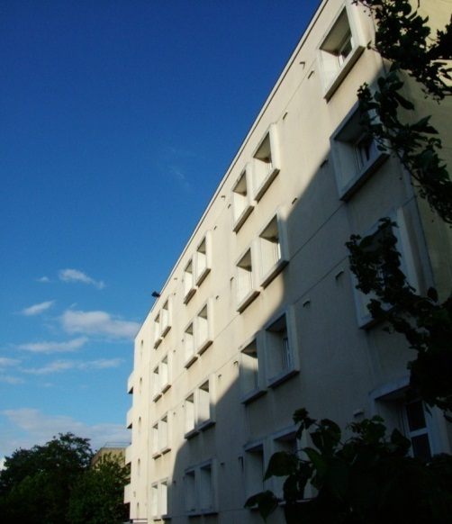
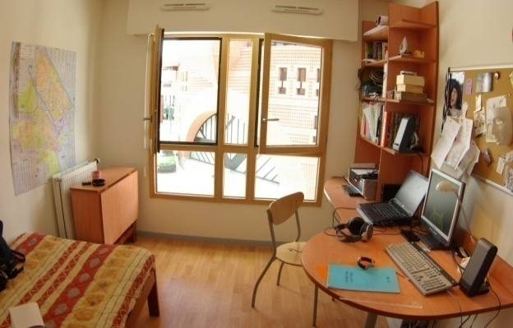
La MAISEL (Student Housing) www.maisel.it-sudparis.eu
700 student housing facilities: dorms and studios located in 6 buildings
Priority housing for first year students
Moderate rental fees (beginning at 400 Euros before State aid)
Dorms and studios equipped with telephone and internet access
Individual bathrooms, common kitchens, washing machines and dryers at your disposal…

Slide 13
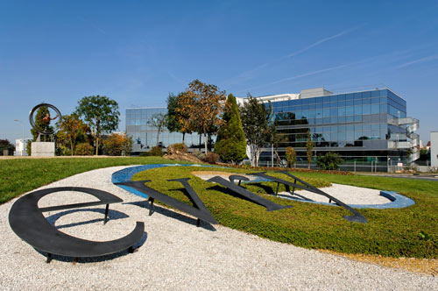
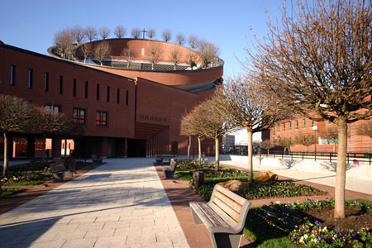
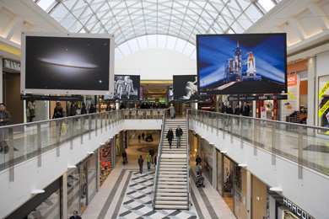
Évry A Green, Young, Academic City www.mairie-evry.fr
A top level scientific and economic center: Génopole, Arianespace, Paris School of Mines, University, TEM & TSP, CNES, largest Hospital center in the Paris area…
A green city: 220 hectares of vegetation, 6 large urban parks
2 RER stations, 23 sports facilities, commercial center, movie theaters, swimming pool, ice skating rink, theater…
A young city: 13.2% students
Close to Paris (35 kms), its cultural life and economic activities

Slide 14
Thank you for your attention
www.telecom-em.eu
bhumika.gupta@telecom-em.eu

